Slide 1
Chapter 6: Database Design Using the E-R Model

Slide 2
Extended E-R Features

Slide 3
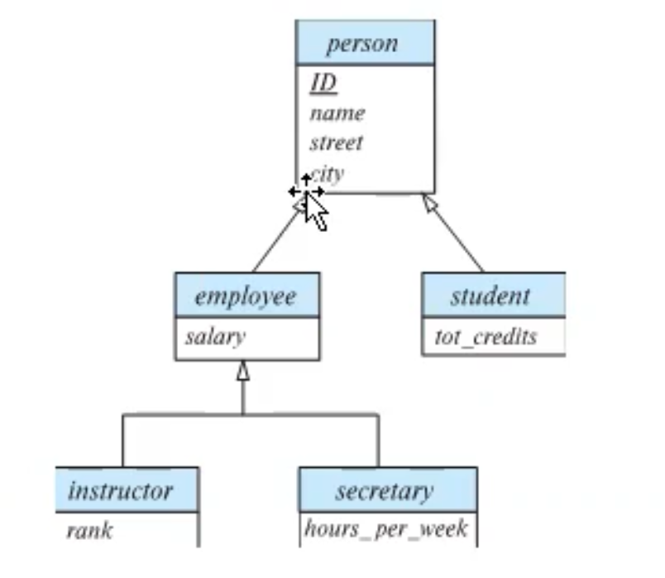
Specialization
Top-down design process; we designate sub-groupings within an entity set that are distinctive from other entities in the set.
These sub-groupings become lower-level entity sets that have attributes or participate in relationships that do not apply to the higher-level entity set.
Depicted by a triangle component labeled ISA (e.g., instructor “is a” person).
Attribute inheritance – a lower-level entity set inherits all the attributes and relationship participation of the higher-level entity set to which it is linked.
Notes:
Employee and students are people. (They are 2 subgroups of people)
Employee IS A person (Triangle)
Employees inherited all the properties from the person entity.

Slide 4
Specialization Example
Overlapping – employee and student
Disjoint – instructor and secretary
Total and partial
Notes:
Overlapping: Students can be an employee and employees can also be students. Ex: Graders and TA’
Disjoint: The instructor cannot be secretary and vice versa.

Slide 5
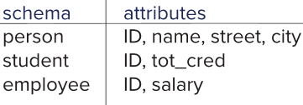
Representing Specialization via Schemas
Method 1:
Form a schema for the higher-level entity
Form a schema for each lower-level entity set, include primary key of higher-level entity set and local attributes
Drawback: getting information about, an employee requires accessing two relations, the one corresponding to the low-level schema and the one corresponding to the high-level schema
Notes:
5

Slide 6
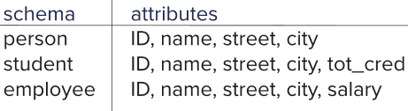
Representing Specialization as Schemas (Cont.)
Method 2:
Form a schema for each entity set with all local and inherited attributes
Drawback: name, street and city may be stored redundantly for people who are both students and employees
Notes:
6

Slide 7
Generalization
A bottom-up design process – combine a number of entity sets that share the same features into a higher-level entity set.
Specialization and generalization are simple inversions of each other; they are represented in an E-R diagram in the same way.
The terms specialization and generalization are used interchangeably.

Slide 8
Completeness constraint
Completeness constraint -- specifies whether or not an entity in the higher-level entity set must belong to at least one of the lower-level entity sets within a generalization.
total: an entity must belong to one of the lower-level entity sets
partial: an entity need not belong to one of the lower-level entity sets – It’s the default.

Slide 9
Completeness constraint (Cont.)
Partial generalization is the default.
We can specify total generalization in an ER diagram by adding the keyword total in the diagram and drawing a dashed line from the keyword to the corresponding hollow arrow-head to which it applies (for a total generalization), or to the set of hollow arrow-heads to which it applies (for an overlapping generalization).
The student generalization is total: All student entities must be either graduate or undergraduate. Because the higher-level entity set arrived at through generalization is generally composed of only those entities in the lower-level entity sets, the completeness constraint for a generalized higher-level entity set is usually total

Slide 10
Aggregation
Consider the ternary relationship proj_guide, which we saw earlier
Suppose we want to record evaluations of a student by a guide on a project
Notes:
Consider this ternary relationship.

Slide 11
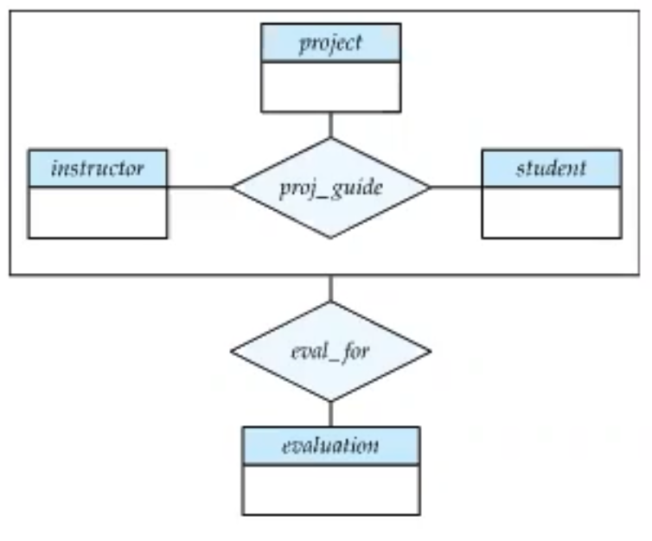
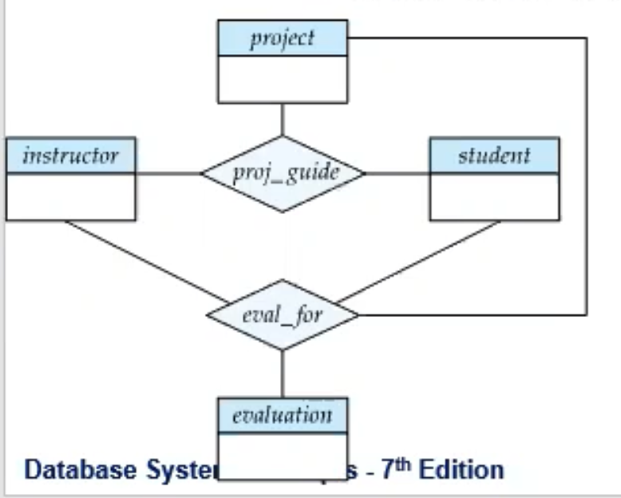
Aggregation (Cont.)
Relationship sets eval_for and proj_guide represent overlapping information
Every eval_for relationship corresponds to a proj_guide relationship
However, some proj_guide relationships may not correspond to any eval_for relationships
So we can’t discard the proj_guide relationship
Eliminate this redundancy via aggregation
Treat relationship as an abstract entity
Allows relationships between relationships
Abstraction of relationship into new entity

Slide 12
Aggregation (Cont.)
Eliminate this redundancy via aggregation without introducing redundancy, the following diagram represents:
A student is guided by a particular instructor on a particular project
A student, instructor, project combination may have an associated evaluation
Notes:
12

Slide 13
Reduction to Relational Schemas
To represent aggregation, create a schema containing
Primary key of the aggregated relationship,
The primary key of the associated entity set
Any descriptive attributes
In our example:
The schema eval_for is:
eval_for (s_ID, project_id, i_ID, evaluation_id)
The schema proj_guide is redundant.

Slide 14
End of Chapter 6

